Slide 1
Investigation of Student Performance dataset
Courtesy of the UCI Machine Learning Repository
Mark Young
12/18/2024

Slide 2
Student Performance Dataset
Data on student achievement in two Portuguese high schools
Collected with reports and questionnaires
Reports grades in two subjects, math and Portuguese

Slide 3
Questions
What factors (e.g., study time, parental education) most influence student grades in math and Portuguese courses?
Are there noticeable differences in performance between male and female students for Portuguese and Math?

Slide 4

Benefits of analysis
Help students succeed
Identify students who need extra help
Predict student success and failure

Slide 5
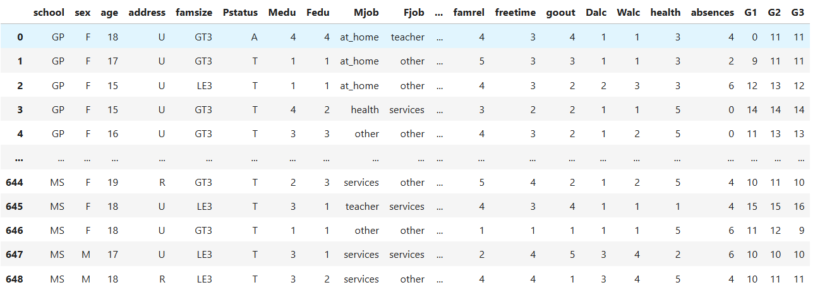
Methodology
Sample of data:
Data came from UCI Machine Learning Repository
Analysis was done in Jupyter notebooks using python

Slide 6
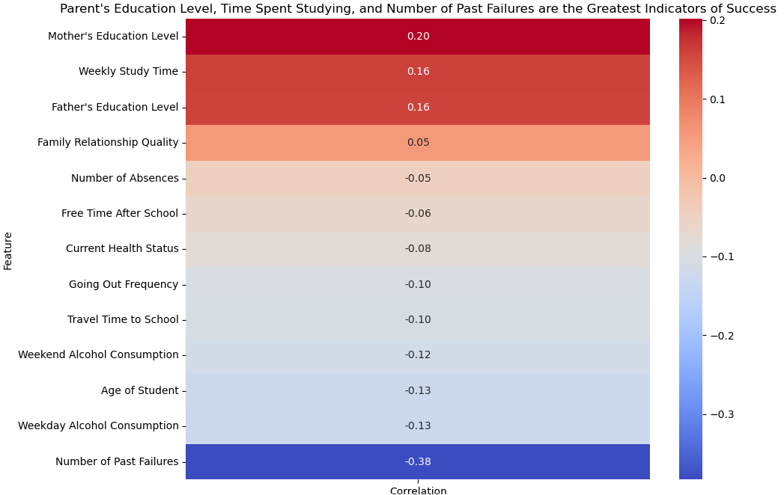
Results:
Maintaining composure

Slide 7
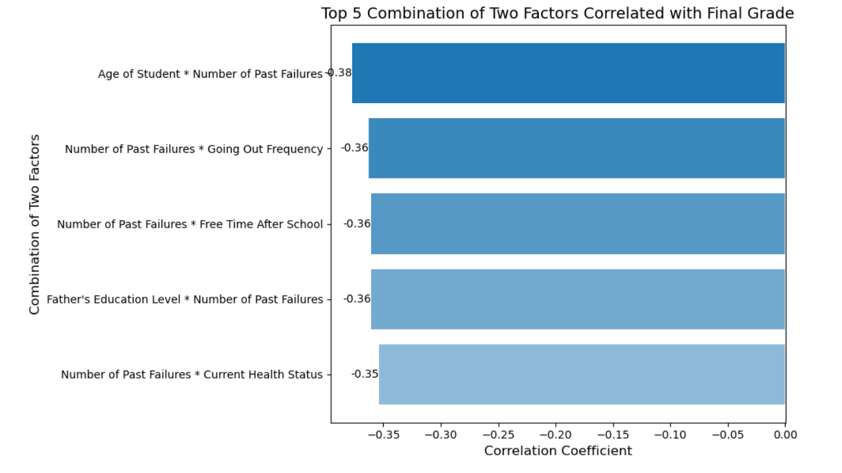
Speaking engagement metrics

Slide 8
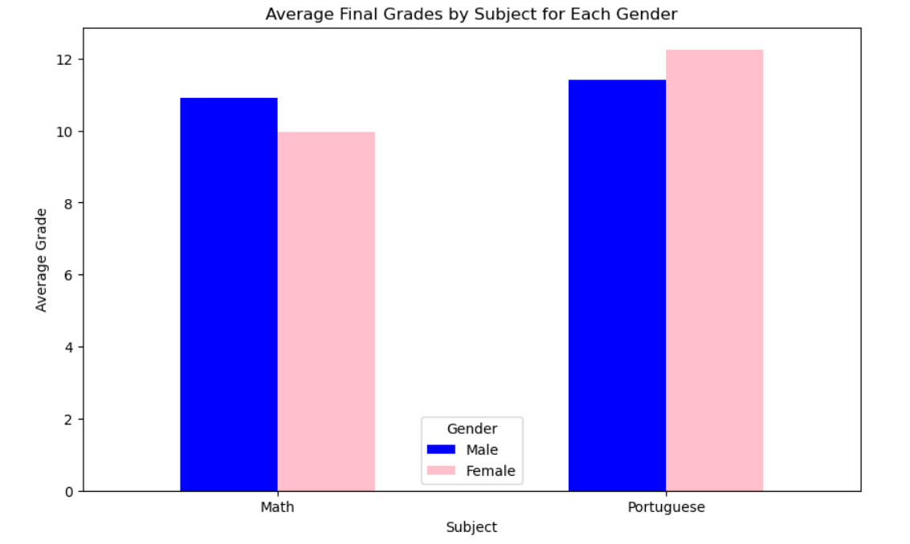

Slide 9
Future Questions
Explore more of the categorical data
How do extracurricular activities influence academics?
How does travel time to school impact final grades?
What is the effect of weekend alcohol consumption on performance?

Slide 10
THANK YOU for your time
Any questions?

